Slide 1
Techniques for Calibrating COCOMO Estimating Models
Dan Ligett
Softstar Systems
Ligett@SoftstarSystems.com
www.SoftstarSystems.com
(603) 672-0987

Slide 2

Calibration Overview
Local Calibration
What’s best fit?
Compare tools & methods

Slide 3
What’s a Local Calibration?
Calibrated to your completed projects
Best fit to your environment
New Effort or Schedule Equation
  Multiplier Only
  Multiplier and Exponent Base
Not adding a new Cost Driver

Slide 4
Why do a Local Calibration?
Fixes a multitude of sins:
Unusual standard for counting effort
  Hours per Staff-Month
  What effort is included
Nonstandard cost driver definition
  Local definition of ACAP High, etc.
Idiosyncratic counting of SLOC
  Physical lines
As long as you’re consistently wrong, you’re not wrong!

Slide 5
Why do a Local Calibration?
Accuracy. A local calibration means you get an equation that is the best fit to YOUR environment.
You may want to do several local calibrations – for different types of projects, or different tool sets.

Slide 6

What data do you need?
Actual SLOC
EAF & SCED setting, Scale Factors
Actual Effort, Hours per Staff-Month
Actual Duration (to calibrate schedule equation)
You need:
5 data points to calibrate the multiplicative constant
10 data points to calibrate the constant & exponent

Slide 7
Calibration Subtleties
To combine data points in a calibration, they must be comparable (apples & apples)
Hours per Person-Month
  Must calibrate with Normalized Effort
  Normalized Effort = Actual Effort * ( HPM / 152 )
  Example: Actual Effort = 100 PM, local HPM = 140 hours / PM
  Normalized Effort = 100 * ( 140 / 152 ) = 92.1 PM
SCED Cost Driver
  Must calibrate with Normalized Duration
  Normalized Duration = Actual Duration / Schedule Acceleration
  Example: Actual Duration of 75 months, SCED Very Low
  Normalized Duration = 75 / 0.75 = 100 Months

Slide 8
How do you define Best Fit?
So what's a best fit? The usual scheme is to use least squares.
But it's easy to imagine different definitions of "best fit".
Minimize the sum of absolute difference
Minimize the sum of the square of the difference
Real space COCOMO 81
Log space COCOMO II
Minimize the sum of the cube or fourth power of the difference
Best Pred(.10) or Best Pred(.15)
Best least squares such that no project is underestimated (!)

Slide 9
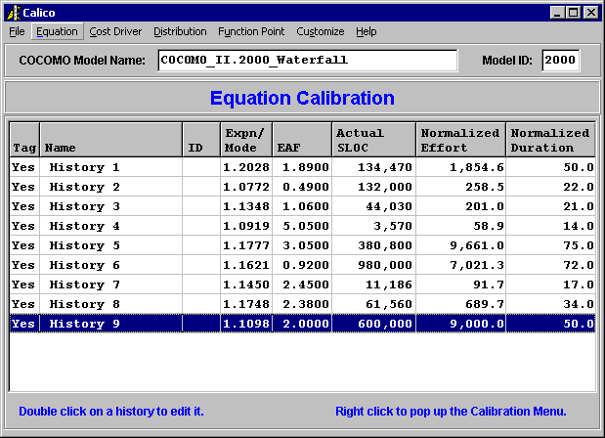
Sample data adapted with permission from Table 4.17 of Software Estimation with COCOMO II

Slide 10
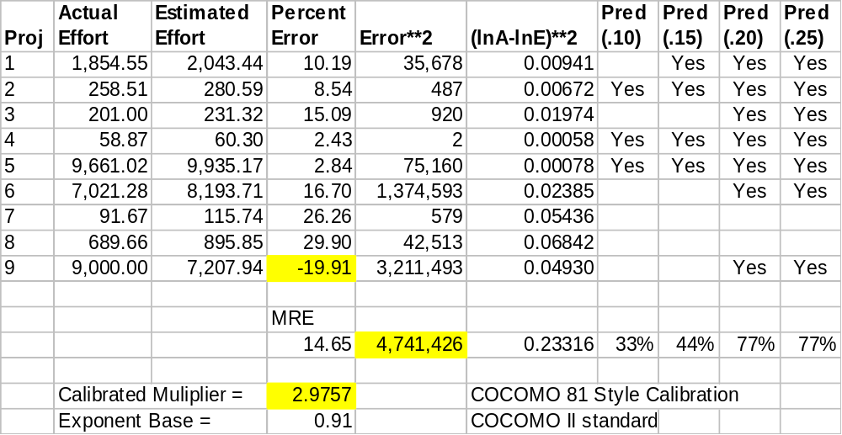
Sample COCOMO 81 calibration results (adapted from a Calico report)

Slide 11
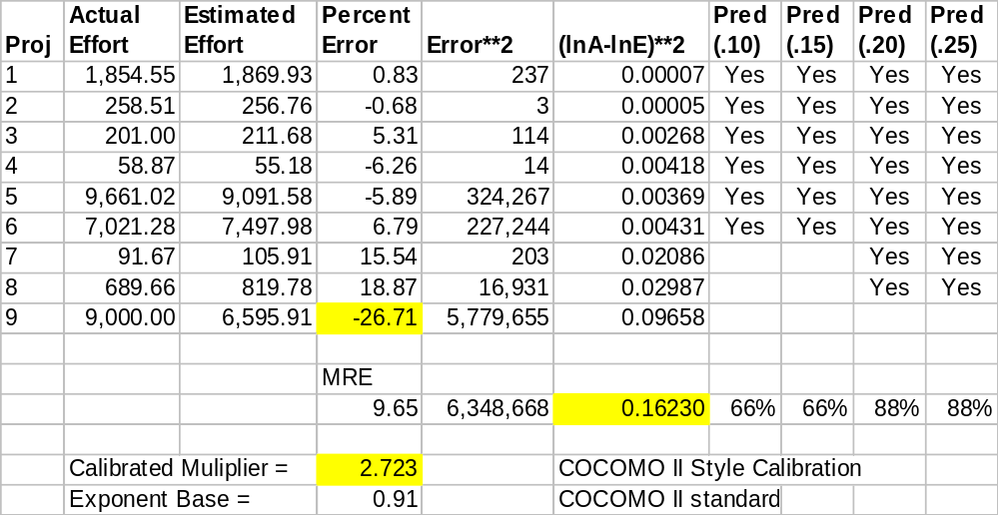
Sample COCOMO II calibration results
(adapted from a Calico report)

Slide 12
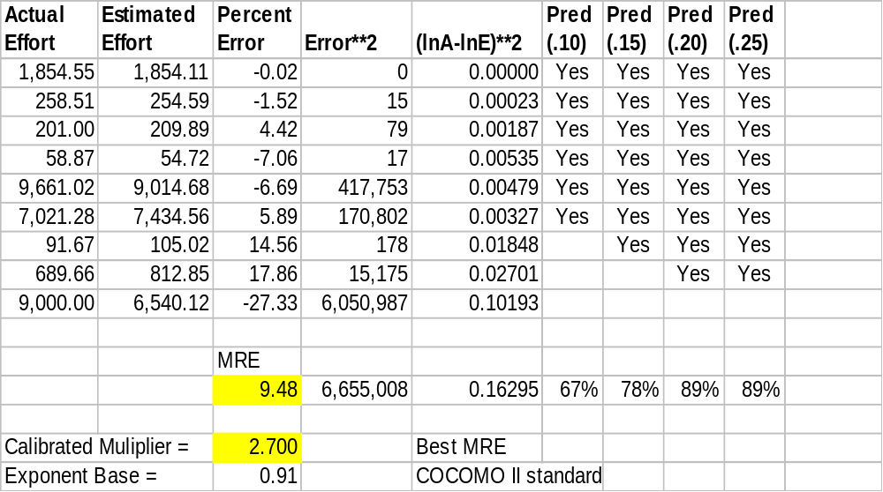
Sample calibration results, BEST MRE

Slide 13
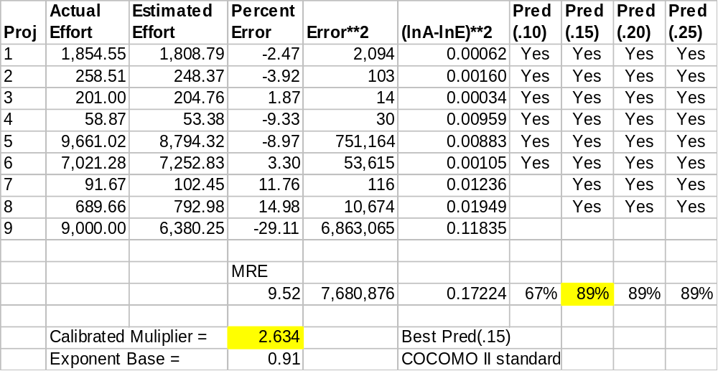
Sample calibration results, Best Pred(.15)

Slide 14
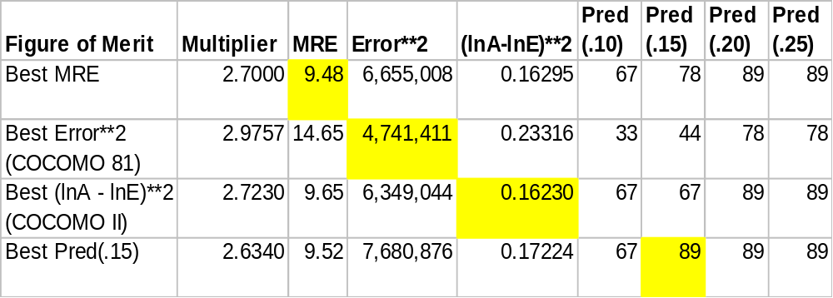
How do you define Best Fit?

Slide 15
Comparing the schemes
COCOMO 81 calibration minimizes error in real space
COCOMO II calibration minimizes error in log space
Using a different definition of Best Fit resulted in a 10% difference in the calibrated multiplier
MRE is better for COCOMO II style (in this example…)
Pred() is better for COCOMO II style (in this example…)
Some of these stats (e.g. MRE) require guess-and-check
Some are dangerous (e.g. PRED(.15) discards an outlier!)
Statistics lets you make an informed choice

Slide 16
Calibration Tools
USC Tool
Calico
Spreadsheet
  http://www.softstarsystems.com/calico.htm
Homegrown spreadsheet or program
  Based on COCOMO II cookbook presented here

Slide 17
Calibration with USC Tool
Free
Widely available
Defects
  Doesn’t handle HPM properly
  Schedule Equation wrong

Slide 18
Calibration with Calico
Free
Downloadable from www.SoftstarSystems.com
Handles HPM & SCED problems
Nice statistics and report
Pick & choose projects from your “History” files
Converts Costar estimates to history files
  Computes EAF for you, which can be hard with components
Creates model files with new equations for Costar
You can use it as a standard data collection tool

Slide 19
Calibration with Spreadsheet
Free
Downloadable from www.SoftstarSystems.com
You can dissect it
You can customize it
You can add your own statistics
Doesn’t handle HPM or SCED nuances

Slide 20
Calibration with a Homegrown Tool
Multiplier-only Calibration (COCOMO II style)
  Details on next slide
  See spreadsheets for an example: www.softstarsystems.com/calico.htm
Multiplier-only Calibration (COCOMO 81 style)
  Details in Software Engineering Economics
  See spreadsheets for update to COCOMO II
Multiplier & Exponent Calibration
  Details in Software Engineering Economics
  See spreadsheets for update to COCOMO II

Slide 21
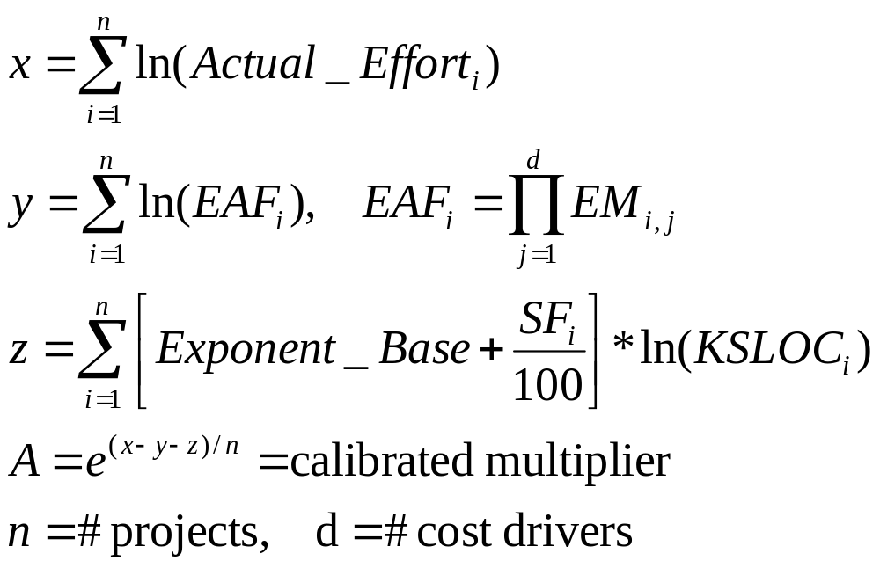
COCOMO II style Multiplier Calibration

Slide 22
Conclusions
Local calibration is good for you.
With most data sets, all of the definitions of best fit will yield similar results. But, check the stats.
Start collecting data now.
As few as 5 data point will get you started.
Multiplier-only calibration is most conservative.
Use a good tool to CALIbrate COcomo.

